Slide 1

SUPPLY CHAIN MANAGEMENT
"Predict the future, optimize the present—supply chain analytics makes it happen."

Slide 2
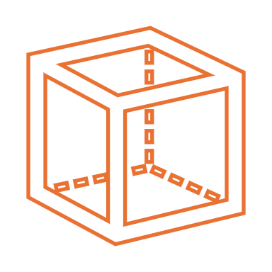
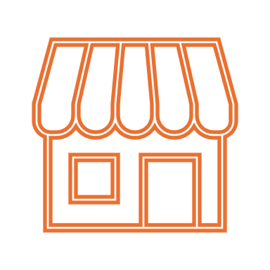


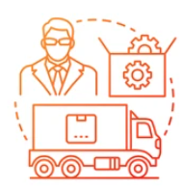
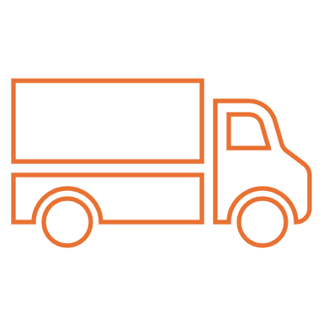
INTRODUCTION
In Today’s interconnected world, Supply chain management is not just about moving the products from point A to point B . It’s about creating a seamless resilient network that adapts to changing demands. A well-managed supply chain ensures that the right products are delivered to the right place at the right time and at the lowest cost. while maintaining quality and customer satisfaction . It includes activities such as demand planning, finances, processes, inventory management and transportation. In this blog, we will discuss the essentials of supply chain management.
Supplier
Retail
Raw Material
Factory
Distribution
Customer

Slide 3



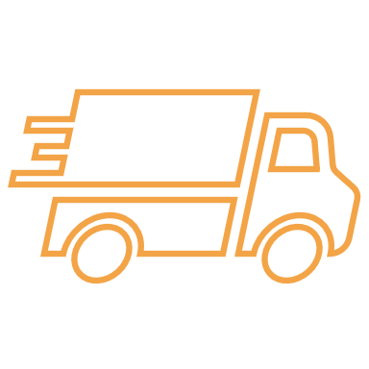

STAGES OF SUPPLY CHAIN MANAGEMENT
Supply Chain Management involves a series of stages that help companies manage the flow of goods and services from raw materials to the final customer. These are the five stages of Supply chain Management.
1.Planning:
Planning is the initial stage in Supply chain management, to find out the best possible solution to fulfill the requirement. Effective planning in supply chain management requires a broad set of knowledge areas to ensure accurate forecasting, efficient resource allocation and smooth operations.
Planning
Sourcing
Supply chain management
Process
Manufact
Delivery
Returns

Slide 4
2.Sourcing :
Sourcing in supply chain management encompasses the entire procurement process, including identifying and selecting suppliers, procuring raw materials or components, managing supplier relationships and inventory ensuring timely payments to suppliers.
3.Manufacturing:
Manufacturing is a production phase where the raw materials are transformed into finished products. This includes scheduling production, procuring raw materials, and managing resources to ensure smooth operations. Quality control is essential with inspections during and after production to maintain standards.
4.Delivery:
Delivery is a critical phase where finished goods are transported from manufacturing facilities to distribution centers, retailers, or end customers. It also involves managing warehousing operations, tracking shipments in real-time and ensuring proper handling to maintain product quality. The goal is to optimize delivery processes while meeting customer expectations and minimizing cost
5.Returns:
The final stage of the supply chain process returns but crucial aspect of supply chain management. This phase involves the systematic handling of returned products, defective items, excess stock, and waste generated throughout the supply chain. The returns process aims to minimize waste, reduce costs and promote sustainable practices by efficiently managing product returns,

Slide 5






SUPPLY CHAIN DATA ANALYTICS
Supply chain data analytics acts as a bridge between the data and its rightful use for corporations for Strategic decision making. It’s a key part of supply chain management. It involves collecting, analyzing, and interpreting data from various supply chain activities, such as procurement, manufacturing, inventory management, logistics and customer delivery. These analytics help companies achieve a lean supply chain, prepare for the future and better understand risks.
Inventory Management
Strategy
Manufacturing
Supply Chain Data Analytics
Logistics
Planning
Warehousing

Slide 6
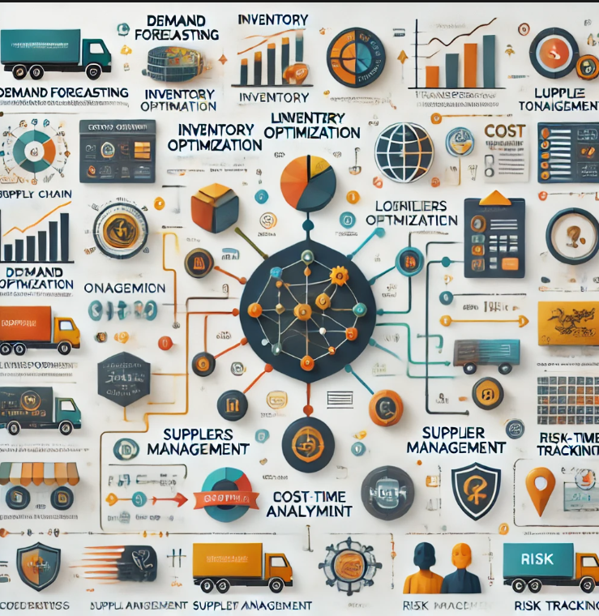
KEY FACTOR OF SUPPLY CHAIN ANALYTICS
Demand Forecasting:
Demand forecasting involves predicting future customer demand for products or services based on historical data, seasonal trends, market conditions. This helps in businesses production planning, inventory management and order fulfillment.
2. Inventory Optimization:
Inventory optimization focuses on maintaining the ideal inventory levels to meet customer demand while minimizing costs such as storage and obsolescence.
3. Supplier Performance Analysis:
Supplier performance analysis is the process of evaluating and monitoring suppliers based on key performance indicators (KPIs) such as on-time delivery, product quality and cost efficiency. It allows businesses to identify high-performing suppliers, manage supplier risks, and make data-driven decisions.

Slide 7
TYPES OF SUPPLY CHAIN ANALYTICS
Supply chain analytics involves the use of data analysis tools and methodologies to understand supply chain processes, identify inefficiencies, predict future trends and make informed decisions to optimize the supply chain.
Descriptive Analytics:
This type of analytics focuses on understanding what has happened in the past within the supply chain. It uses historical data to identify patterns, trends and insights.
Focus: Understanding historical data to gain insights into past performance.
Techniques: Data aggregation, data mining, data visualization.
Descriptive
Prescriptive
What happened ?
What Should I do ?
Types of Supply Chain Analytics
Predictive
Diagnostic
What will happen?
Why did happen ?

Slide 8
2. Diagnostic Analytics:
Diagnostic analytics goes a step further by not only describing past events but also attempting to understand why those events happened.
Focus: Identifying the root causes of inefficiencies and problems within the supply chain.
Techniques : Drill-down analysis, root cause analysis.
3.Predictive Analysis:
Predictive analytics uses statistical models and forecasting techniques to understand the future. It analyzes historical data to predict future outcomes such as demand forecasts and supply chain risks.
Focus: Forecasting future events and predicting potential outcomes.
Techniques: Forecasting models , machine learning.
4. Prescriptive Analytics:
Prescriptive analytics provides recommendations on what actions to take to achieve specific goals or solve problems.
Focus: Providing recommendations and actionable insights for optimizing supply chain operations.
Techniques: Optimization algorithms, decision support systems.

Slide 9


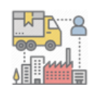
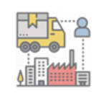





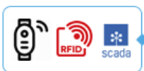


WORKFLOW OF SUPPLIER CHAIN ANALYTICS
Sales
Key vault
App Service
Event hub
Azure Databricks
Power bi
Azure Datawarehouse
Azure Data Lake
Logic apps
Mobile Device
App Service
IOT hub

Slide 10
Supply chain analytics is the practice of collecting and analyzing data from every aspect of a company’s supply chain to gain insights that can help optimize operations and profitability.
It showcases how raw data from various sources is transformed into actionable insights and business results.
Data Collection and Integration:
Data is gathered from various sources across the supply chain
Including:
Sales records
Inventory levels
Customer interactions
Supplier information
Logistics data
This data is integrated into a central repository like a data warehouse or a data mart. This creates a single source of truth for analysis.

Slide 11
2.Data Analysis and Transformation:
Data Cleaning: Raw data is cleaned to ensure accuracy and remove inconsistencies.
Data Transformation: Data is transformed into a format suitable for analysis such as aggregating data, creating new variables and normalizing values.
Querying and Reporting Tools: These tools allow users to extract specific information from the data warehouse, create reports and analyze trends.
3. Insight Generation:
Decision Support Systems: These systems use analytical models and algorithms to analyze data and provide insights into potential outcomes.
Forecasting Technology: Predictive models are used to forecast future demand, identify potential disruptions and optimize inventory levels.
Visualization Technology: Data is visualized using charts, graphs and dashboards to make complex information easily understandable.

Slide 12
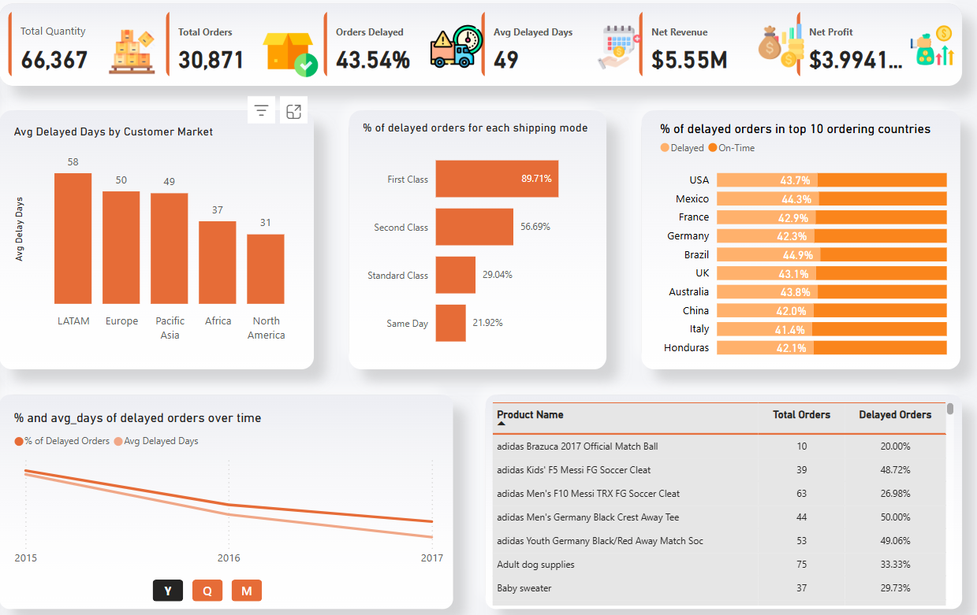
Order Performance Dashboard

Slide 13
This dashboard provides insights related to order performance, delays ,trends and inventory management, necessitating immediate action to streamline processes, optimize stock levels and improve overall warehouse performance.
30,871 total orders, 43.54% of orders were delayed across both warehouses, with an average delay of 49 days.
Delayed orders were associated with First Class shipping mode.
LATAM has the highest average delay 58 days, followed by Europe 50 days and Pacific Asia 49 days.
North America and Africa have the lowest average delays 31 and 37 days .
Brazil has the highest delay rate in the top 10 %
From 2015 to 2017 the percentage of delayed orders and the average days of delays have steadily decreased, reflecting improved processes or logistics.
Forecasts warehouse labor requirements in alignment with procurement and shipping schedules.

Slide 14
Order Performance KPI
These KPIs collectively aim to monitor Order performance, order efficiency and financial outcomes to enable effective decision-making.
1. Total Quantity:
Measures the total number of products available or processed, providing insight into overall inventory levels.
Formula:
Total Quantity=∑(Quantity of all orders or products)
2. Total Orders:
Tracks the total number of orders processed to assess overall demand and operational scale.
Formula:
Total Orders=Count of all unique orders (Order ID)
3. Orders Delayed (%)
Indicates the percentage of orders that were delayed, highlighting operational inefficiencies.
Formula:
Orders Delayed (%)=( Number of Delayed Orders /Total Orders)*100
Total Quantity
66,367
Total Orders
30,871
Orders Delayed
43.54 %
Avg Delayed Days
49
Net Revenue
$5.5 M
Net Profit
$3.9941

Slide 15
4. Average Delayed Days:
Provides the average number of days delayed orders were late, offering insights into shipping and logistics issues.
Formula:
Avg. Delayed Days= ∑(Delayed Days for all delayed orders) / Number of Delayed Orders
5. Net Revenue:
Measures the total revenue generated from all orders, helping to evaluate financial performance.
Formula:
Net Revenue=∑(Order Total Amount)
6. Net Profit:
Calculates the profitability of operations after accounting for costs.
Formula:
Net Profit=Net Revenue−Total Costs (including inventory, shipping, and operations)

Slide 16
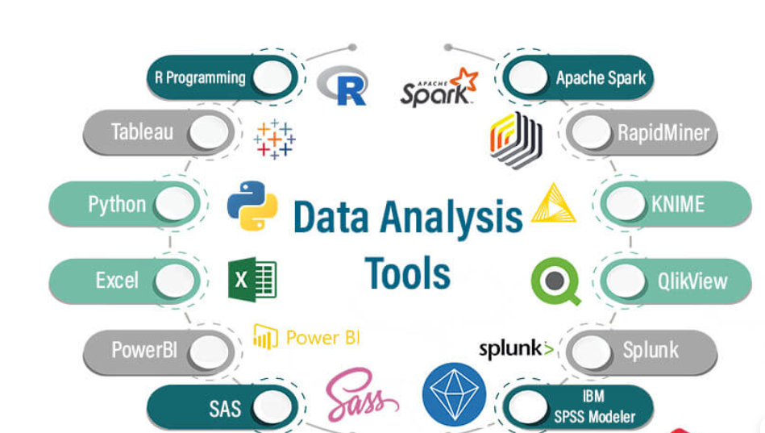
SUPPLY CHAIN INNOVATION
To enhance inventory management and optimize supply chain operations, businesses can use a combination of advanced techniques and powerful tools.
1.Microsoft Power BI:
Microsoft Power BI is a powerful business analytics tool that enables users to visualize and share insights from their data, displaying key metrics.
2. Azure Synapse Analytics:
Storing supply chain data for complex analytical querying. Integrating supply chain data from hundreds of data sources across the company’s divisions, subsidiaries. To perform analytical querying in seconds.
3.Amazon Redshift:
Warehousing for supply chain big data. Amazon Redshift’s integration with machine learning and data science tools allows supply chain teams to build predictive models for demand forecasting based on historical sales data

Slide 17
4. Logic Apps:
Logic Apps is a cloud platform where you can create and run automated workflows with little to no code. By using the visual designer and selecting from prebuilt operations, you can quickly build a workflow that integrates and manages your apps, data, services, and systems.
5.Data Bricks:
Databricks is a cloud-based platform that helps businesses use data, analytics and artificial intelligence . It allows users to build, scale, and manage data and AI, including generative AI and machine learning models.
6. Konstanz Information Miner:
Konstanz Information Miner is a free open-source data analytics, reporting and integration platform. It is designed for visual programming and allows users to build workflows for tasks such as data preprocessing, machine learning and predictive analytics.
7. Splunk:
Splunk is a platform for collecting, analyzing and visualizing machine-generated data in real time. It is widely used for IT operations, security monitoring, troubleshooting and business analytics.

Slide 18

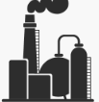
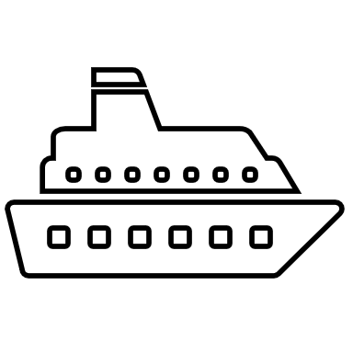
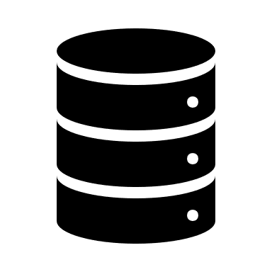



CASE STUDY : Optimizing Inventory and Transit Losses
A large process manufacturer - chemical/ oil company, etc., imports crude and other raw materials from various countries through a complex procurement mechanism involving multiple stakeholders. The crude may be transported in a mother vessel before being transferred to smaller vessels to finally arrive at the nearest jetty or pipeline of the manufacturer.
Purchase Order
Manufacturer
Mother vessel
Survey Report
Ship Master data
Surveyor Report
J
Inventory Report
Supplier
Jetty
Vessel info
Quality
Surveyor Report

Slide 19
Challenges:
Manual Data Collection: Inventory and operational data were recorded manually on paper, leading to inefficiencies and errors.
Lack of Systematic Tracking: Key metrics like tank inventory, material quantities, and dispatch details were monitored without automation.
Limited Insights for Decision-Making: Due to siloed systems and manual processes, there was no real-time visibility into operations, preventing timely interventions or proactive decision-making.
Post-Mortem Analysis Only: The existing ERP system only allowed for post-mortem analysis, which was reactive and didn't help in identifying or addressing inefficiencies in real time.
Inability to Pinpoint Issues: The lack of a unified system made it difficult to identify whether in procurement, dispatch or during transit.
Unseen Costs: The company was unaware of the hidden costs and losses incurred due to inefficiencies in the procurement and dispatch processes.

Slide 20





Solution:
Purchase Order
Manufacturer
Mother vessel
Reconciliation
Survey Report e-form
Ship Master data
Surveyor Report e-form
Supplier
JJJJ
Inventory Report
Jetty
Vessel info
Quality
Surveyor Report
Arrival Schedule
Red gauge

Slide 21
Digital Transformation of Records:
Transition from physical copies of surveyor reports to e-forms and online records, enabling automated reconciliation with Purchase Order details and generating real-time alerts for discrepancies.
Transit Loss Monitoring:
Implement end-to-end visibility into transit losses at each stage of the procurement process, from the mother vessel to storage tanks, allowing for timely identification and resolution of issues.
Automated Flow Meter Integration:
Utilize flow meters to maintain automated records of the actual crude oil received, ensuring accurate tracking of material at every stage.
Real-Time Inventory Tracking:
Leverage radar gauges for real-time visibility into inventory levels and oil consumption during specific periods, enabling better decision-making and operational efficiency.

Slide 22
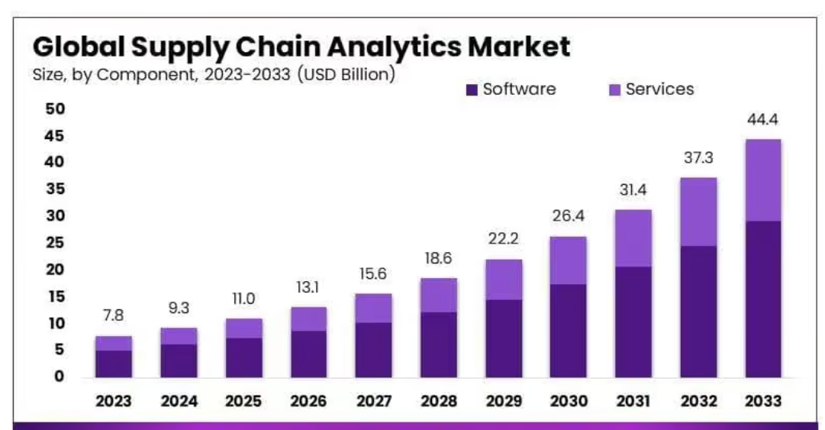
SUPPLY CHAIN ANLAYTICS MARKET TREND
The Global Supply Chain Analytics Market size is expected to be worth around USD 44.4 Billion by 2033 from USD 7.8 Billion in 2023, growing at a CAGR of 19.0% during the forecast period from 2024 to 2033.
Field has expanded due to the rising adoption of IoT and a growing focus on enhancing the efficiency of supply chain operations, including logistics, warehousing, order fulfillment, production and transportation management.
This technology provides businesses with unparalleled insights, enabling them to optimize processes, predict outcomes and enhance decision-making.

Slide 23
Top Countries Market Trend
Europe:
Europe’s supply chain analytics market was valued at $4.7 billion in 2024 and is expected to grow at a CAGR of 10.9% (2024–2033).
Europe’s logistics industry contributes €1 trillion annually, with Germany ranking #1 globally in logistics performance.
2. Asia Pacific:
APAC is the fastest-growing region in supply chain analytics, valued at $7.2 billion in 2024, with a projected CAGR of 13.6% (2024–2033).
APAC accounts for 40% of global manufacturing output, with China contributing 28% of global manufacturing.
3. Middle East and Africa:
MEA's supply chain analytics market was valued at $1.5 billion in 2024, with a CAGR of 9.5% (2024–2033).
Middle East logistics spending accounts for 8.5% of GDP, driven by global trade hubs like Dubai.
4. South America :
South America’s supply chain analytics market reached $1.2 billion in 2024, with a projected CAGR of 8.8% (2024–2033).
Brazil accounts for 60% of South America’s supply chain analytics spending.

Slide 24
5.North America :
The North American supply chain analytics market was valued at $6.5 billion in 2024 and is projected to grow at a CAGR of 11.5% (2024–2033). North America leads with 50% of global adoption of AI-driven supply chain solutions.
6. Germany:
The cognitive supply chain market generated a revenue of USD 512.4 million in 2024 and is expected to reach USD 1,259.7 million by 2033
The Germany market is expected to grow at a CAGR of 16.2% from 2025 to 2030.
7. Japan:
The Japan supply chain management market generated a revenue of USD 1,124.8 million in 2023 and is expected to reach USD 2,965.9 million by 2030. The market is projected to grow at a CAGR of 14.9% from 2024 to 2033.
8.Uk:
The Uk supply chain management market was valued $1.7 billion in 2024 and is expected to grow to $4.6 billion by 2033, with a compound annual growth rate (CAGR) of 11.90%.

Slide 25
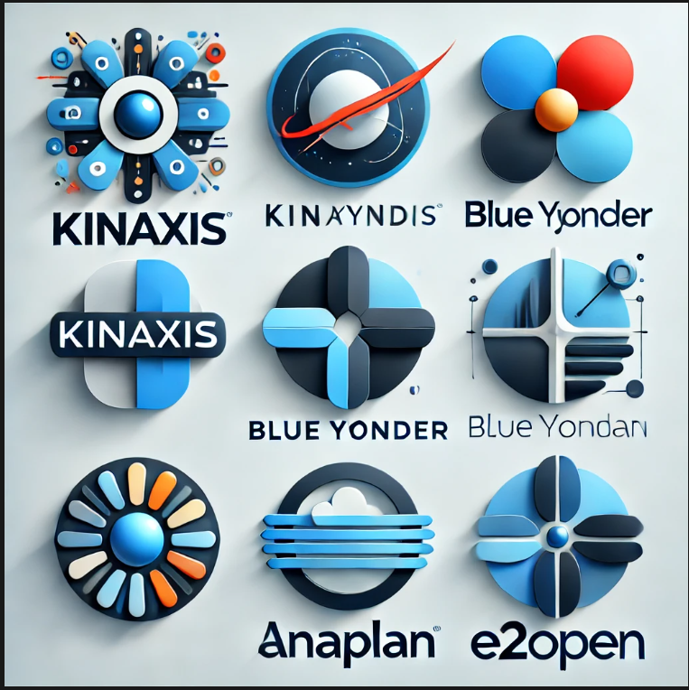
COMPETITORS
Kinaxis:
A cloud-based platform that offers analytics and planning capabilities for supply chains.
Improved demand forecast accuracy by 30% reduced supply chain disruptions by 20% and achieved 40% faster decision-making.
Utilizes predictive analytics to anticipate supply chain trends and concurrent planning techniques to enable real-time synchronization of logistics, demand and capacity planning for agile decision-making
Blue Yonder:
A platform that uses machine learning and AI to provide predictive insights for demand forecasting, inventory management and supply chain planning.
Achieved up to 40% reduction in excess inventory, improved demand forecasting accuracy by 50% and enhanced supply chain efficiency.

Slide 26
Anaplan:
A platform that allows for extended planning and analysis through real-time scenario analysis and collaborative workflow.
Anaplan has helped clients achieve up to 30% faster planning cycles, improve forecast accuracy by 20% and increase operational efficiency by 25%, driving significant cost savings and enhanced decision-making
Anaplan leverages advanced analytics and machine learning-driven predictive modeling to forecast demand, optimize inventory management and enhance supply chain efficiency
E2open:
A platform that provides an automated solution with advanced demand sensing and modeling capabilities.
E2open helps businesses reduce excess inventory by up to 30%,improve demand forecast accuracy by 50% and enhance supply chain efficiency by 25%. The platform enables faster decision-making, cutting planning cycles by 20% and driving significant operational improvements.
E2open leverages diagnostic analytics identifies the root causes of supply chain disruptions.

Slide 27
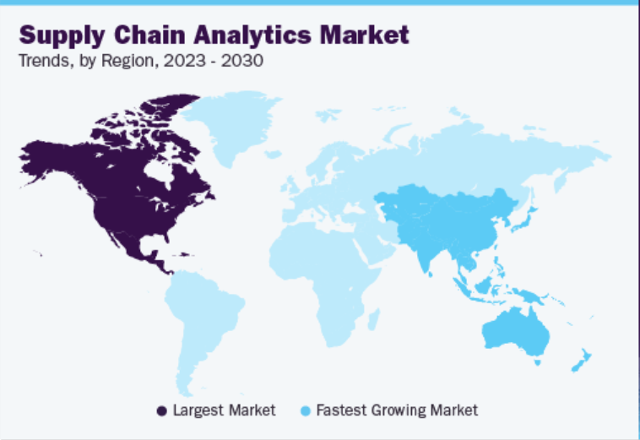
GROWTH RATE
The North America Supply Chain Analytics Market share stood around 41.17% in the global market, with a valuation of USD 2.45 billion. To improve operational efficiency, reduce costs and optimize the supply chain processes has led to the adoption of AI.
The market size for supply chain analytics continues to grow in North America with the USA playing a significant role in this expansion.
With the prominence of technology players in the market and increasing penetration of big data in the retail space, retailers are leveraging supply chain analytics to gain deeper insights into their operations, enhance efficiency and drive profitability.

Slide 28
BUSINESS IMPACT
1. Demand Forecasting:
Predicts future product demand accurately, leading to a 20-35% improvement in forecast accuracy, a 10-20% reduction in carrying costs and a 15-25% reduction in inventory waste.
2.Inventory Management:
Inventory management provides improved insights into inventory levels, resulting in a 20-40% improvement in inventory accuracy and a 10-25% reduction in stockouts and overstock situations.
3.Improved Efficiency:
Enhanced operational workflows, automation and optimized resource allocation lead to a 15-30% increase in overall supply chain efficiency.
4.Real-Time Monitoring:
Real-time monitoring enhances the ability to identify and respond to disruptions, resulting in a 25-40% reduction in response time to disruptions and a 10-20% improvement in on-time delivery rates.

Slide 29
RESHAPE OF SUPPLY CHAIN ANALYTICS
Real time Shipment Monitoring
1.Real-time shipment monitoring :
Real-time shipment monitoring can be a powerful tool for Improving decision-making and enabling proactive adjustment. Businesses can adjust their shipping operations with the use of transportation and supply chain analytics to Reduce delivery time.
2. Enhanced Warehousing Efficiency:
Optimal resource allocation drives efficient warehousing. Data collection eases congestion, streamlines warehouse flow, and ensures timely deliveries.
Improve Revenue
Increased Warehousing Efficiency
Advanced Demand Forecasting

Slide 30
3. Demand Forecasting:
Optimizing the supply chain requires effective inventory management. If organizations can’t satisfy a customer’s request at the appropriate time, they risk losing business to alternative suppliers. Advanced demand forecasting in inventory management with supply chain analytics can improve productivity across several activities.
4. Predictive Maintenance:
Businesses can perform predictive maintenance to reduce downtime .The goal of predictive maintenance is to identify potential equipment breakdowns and enhance preventive maintenance programs by analyzing historical and current data.
5. Improve Revenue & Retailer Satisfaction:
Organizations can better plan their sales and marketing strategies to boost revenue and keep consumers by considering consumer behavior, demographics, and other trends and patterns. Retailers can use this data to better understand their customers’ usage patterns and purchasing habits, as well as to detect slow-moving stock and cross-sell it.
6. Supply Chain Data Visualization:
Supply chain data visualization employs various technologies to illustrate material and product movement. How much inventory is left, where there are delays or issues with the movement of goods and ineffective management

Slide 31
Future Trends of AI/ML and Data in Supply Chain Analytics
The future of supply chain analytics will be increasingly driven by AI/ML operations through predictive analytics, real-time monitoring and automation.
Advanced machine learning models will enhance demand forecasting, optimize inventory management and automate decision-making across the supply chain, leading to greater efficiency and cost savings.
AI will also improve risk management by predicting disruptions, enabling more agile and resilient supply chains. As AI continues to evolve, supply chains will become smarter, more sustainable and better aligned with customer needs, driving future success in the industry.
AI and ML will play a pivotal role in reducing excess inventory and stockouts by analyzing demand patterns and automatically adjusting stock levels based on predictive models. This leads to better cash flow management and reduced storage costs, while ensuring products are always available when needed.

Slide 32
CONCLUSION
Supply chain analytics is rapidly evolving with AI and machine learning, transforming how businesses manage operations. By leveraging predictive analytics, real-time monitoring and automation organizations can forecast demand, optimize inventory and streamline decision-making.
AI enhances risk management, making supply chains more resilient and adaptable to disruptions. As AI-driven solutions become smarter, supply chains will be more efficient, sustainable and aligned with customer needs ensuring long-term competitiveness and success.

